Slide 1
Proposal System Architecture

Slide 2

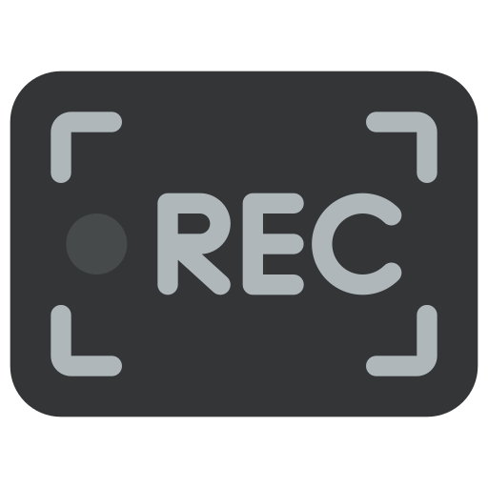


On Cloud
Up to 3 Cameras
On-cloud in AWS
Safety Helmet detection
HSE Manager
RTSP Links
Safety Vest detection
Centralized Dashboard
Network Video Recorder
(NVR)
Safety Glove Detection
Fire and Smoke Detection
Alert/ Notification (Email & Mobile)
**Camera minimum requirement: 1080p@25 fps
Notes:
Our solution can connect with with any online camera, user simply select from multiple visual engines to enjoy real time alert, collect data and analyze them in dashboard.
<number>

Slide 3
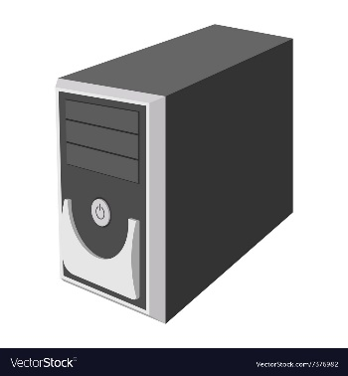
On Premise
On-site Infrastructure
On-premise
Up to 100 Cameras
viAct’s AI Engineer
Deploy AI model
VPN Access
API
AI Detection results, event alerts, processed metadata
HSE Manager
…
RTSP Links
AI Inference
Workstation
Localizes Dashboard
Network Video Recorder
(NVR)
Update AI Models
Raw video clips, detection logs, metadata for model training
viAct’s Engineer
Deploy Dashboard
VPN Access
Alert/ Notification (Email & Mobile)
viAct’s AI Engineer
Continuous training of AI model
VPN Access
AI Training
Workstation
**Camera minimum requirement: 1080p@25 fps
Notes:
Our solution can connect with with any online camera, user simply select from multiple visual engines to enjoy real time alert, collect data and analyze them in dashboard.
<number>

Slide 4
Hybrid (AI Interference at site, Dashboard + Training Cloud)
Up to 10 Cameras
On Cloud AI Training and Dashboard
Network Video Recorder
(NVR)
On-premise
RTSP Links
HSE Manager
API
AI Detection results, event alerts, processed metadata
AI Inference
Workstation
On Cloud Dashboard & Training Workstation
viAct’s AI Engineer
deploy of AI model
VPN Access
Alert/Notification (Email & Mobile)
viAct’s AI Engineer
Continuous training of AI model & Deploy Dashboard
VPN Access
**Camera minimum requirement: 1080p@25 fps
Notes:
Our solution can connect with with any online camera, user simply select from multiple visual engines to enjoy real time alert, collect data and analyze them in dashboard.
<number>

Slide 5
Hybrid (AI Interference + Training at site, Dashboard Cloud)
On-site Infrastructure
On-premise
On Cloud
Up to 100 Cameras
viAct’s AI Engineer
Deploy AI model
VPN Access
API
AI Detection results, event alerts, processed metadata
HSE Manager
…
RTSP Links
AI Inference
Workstation
On cloud Dashboard
Network Video Recorder
(NVR)
Update AI Models
Raw video clips, detection logs, metadata for model training
viAct’s Engineer
Deploy Dashboard
VPN Access
Alert/ Notification (Email & Mobile)
viAct’s AI Engineer
Continuous training of AI model
VPN Access
AI Training
Workstation
**Camera minimum requirement: 1080p@25 fps
Notes:
Our solution can connect with with any online camera, user simply select from multiple visual engines to enjoy real time alert, collect data and analyze them in dashboard.
<number>

